Slide 1
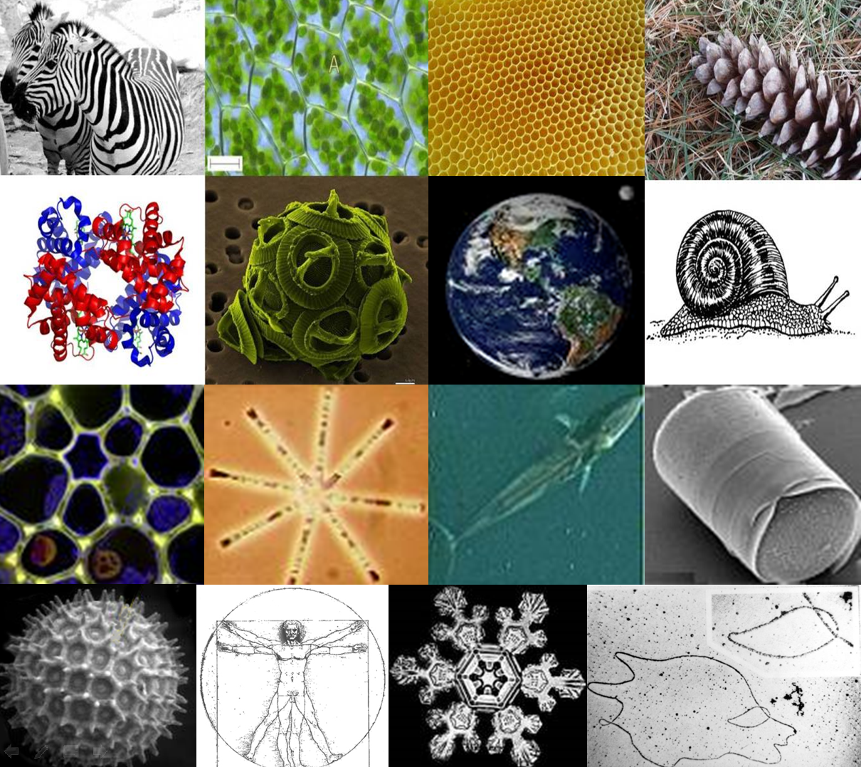
NRICH and being a mathematician

Slide 2
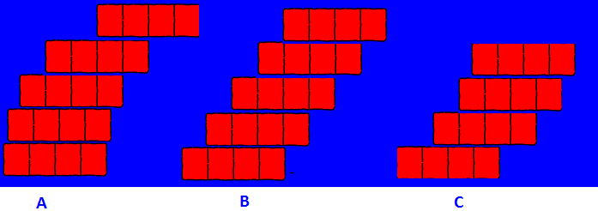
Balancing bricks
Which of these towers of brick do you think would fall over?
If you had lots and lots of bricks how far could you make a tower go?

Slide 3
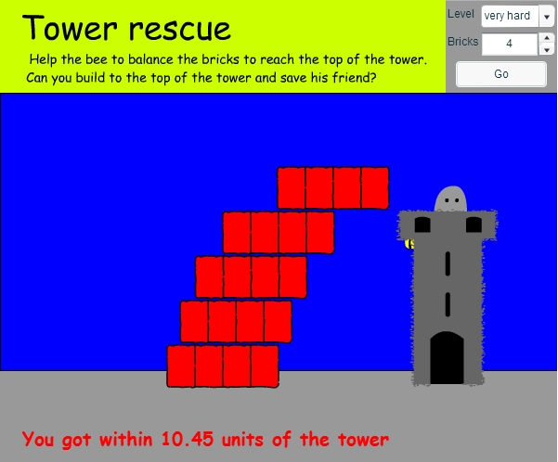
Balancing bricks http://nrich.maths.org/5863

Slide 4
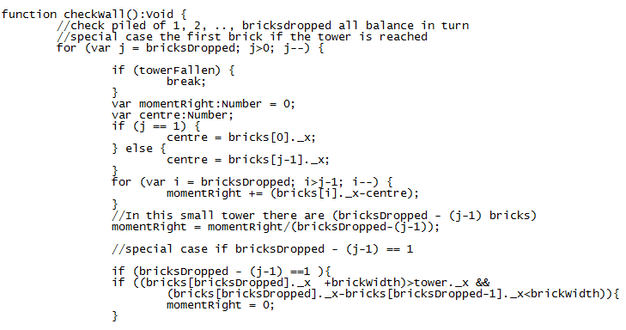
Computer languages look like this

Slide 5
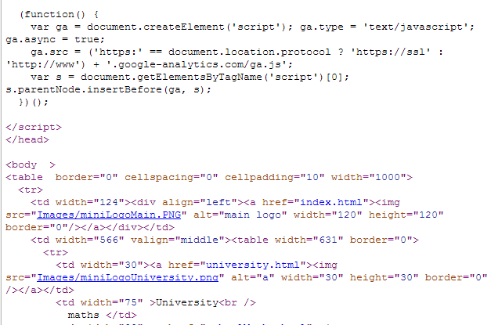
Webpage languages look like this

Slide 6
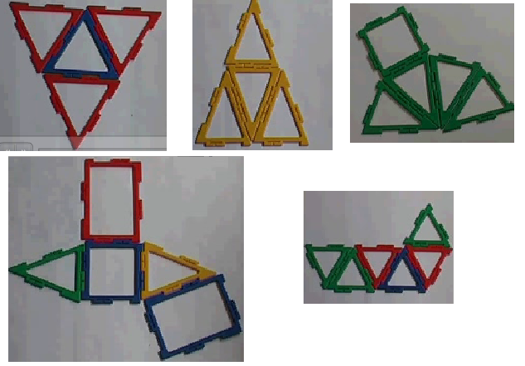
Which of these polydron shapes will close up to make a solid?
http://nrich.maths.org/6307

Slide 7
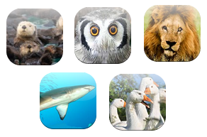
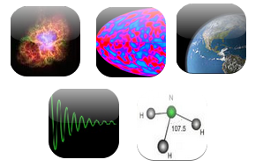
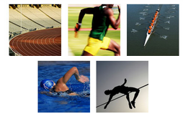
Some maths I have done
Maths about animals
Maths about space and atoms
Maths about sport

Slide 8
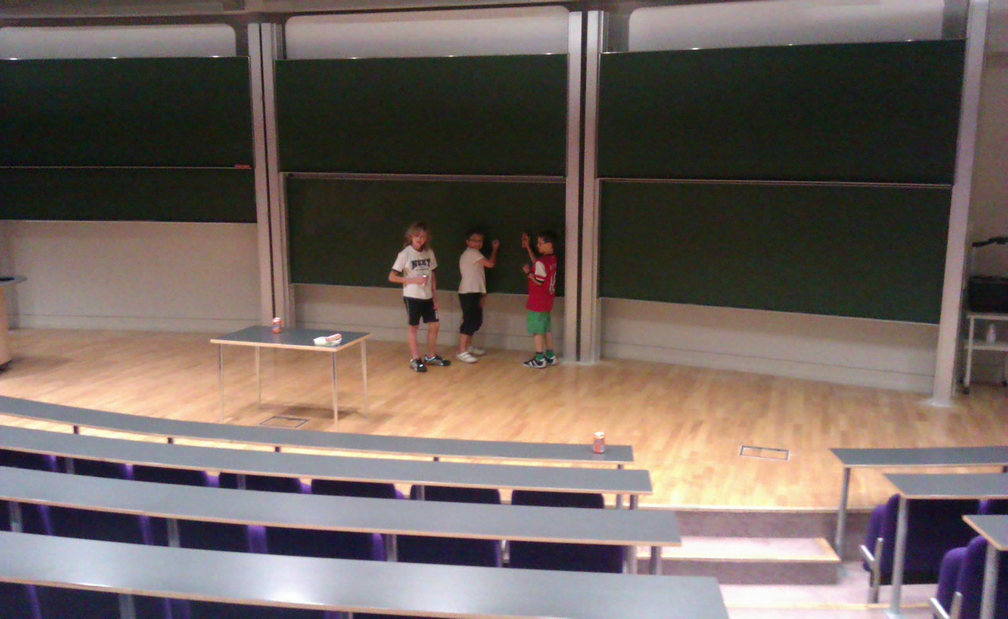
University classrooms are like this

Slide 9
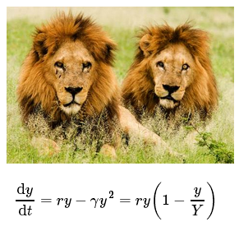
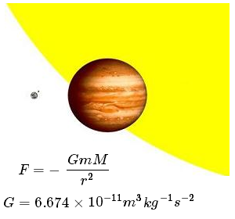
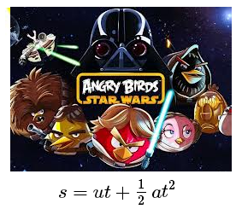
What could you do with maths and science?

